Slide 1
Android Structure - Insight

Slide 2
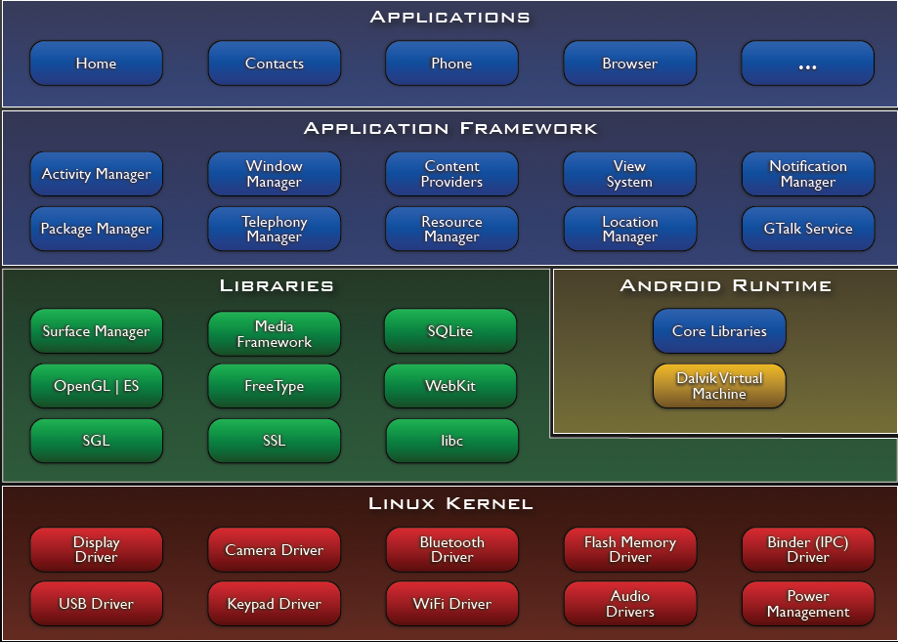
Libraries
Bionic Libc
Function Libraries
Native Servers
Hardware Abstraction Libraries

Slide 3
Libraries
C/C++ libraries：
media：MPEG4 H.264 MP3 JPG PNG .....
WebKit/LibWebCore
SQLite database
2D，3D graphics library

Slide 4
Function Libraries
WebKit
Base on WebKit
Support CSS、Javascript、DOM、Ajax
Multimedia Framework
Base on PacketVideo OpenCORE platform
SQLite
database

Slide 5
Hardware Abstraction Libs
User space C/C++ library layer

Slide 6
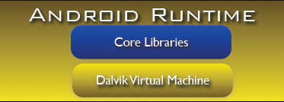
Andoid Runtime
Application Development Language：Java
Dalvik virtual machine
instruction: Dalvik Excutable
Java libraries
Java is compiled into an executable file for Dalvik (dex format)

Slide 7
Operating Environment
Dalvik virtual machine depends on the Linux kernel
Can run multiple Dalvik virtual machines simultaneously
Each Android application executes its Dalvik Executable file(.dex) on its own Dalvik VM.
Dx-compiles Java file into dex file.

Slide 8
Dalvik Virtual Machine
Android custom implementation virtual machine
Provides application portability and runtime consistency
Runs optimized file format (.dex) and Dalvik bytecode
Java .class / .jar files converted to .dex at build time
Designed for embedded environment
Supports multiple virtual machine processes per device
Highly CPU-optimized bytecode interpreter
Efficiently Using runtime memory
Core Libraries
Core APIs for Java language provide a powerful, yet simple and familiar development platform

Slide 9
DVM vs JVM
DVM
Google
Dalvik excutable
JVM
Sun
Java bytecode

Slide 10
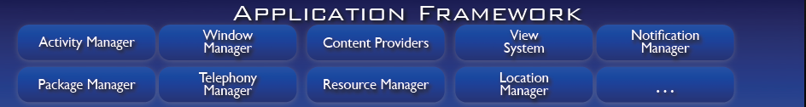
Applications Framework
Activity manager
Manage activities
Content Provider
Share data between applications
Resource Manager
Resource Manager
Notification Manager
Views System
construct UI

